Slide 2
Notes:
Figure 4

Slide 3
R²=0.0436
p=0.2677
Notes:
Figure 5
Q4 is conspicuously empty (except for point where x=7), whereas Q3 contains several points. However, in Q1 & Q2, points appear to slope downwards.
Suggests that for networks that performed worse than db5, having common edges tended to boost performance. However, to exceed db5, rewiring of the network was required.
Key: Q4 empty indicates that the best performing networks are NOT more likely to have common edges with db5.

Slide 4
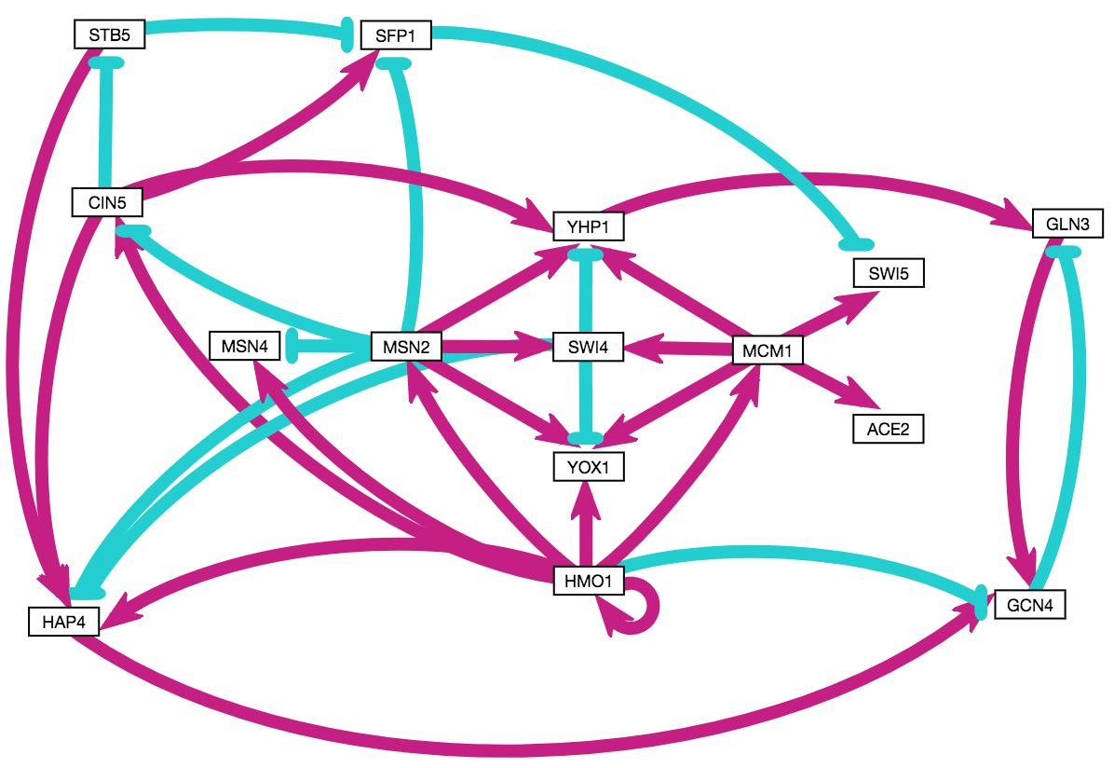
Notes:
Figure 10

Slide 5
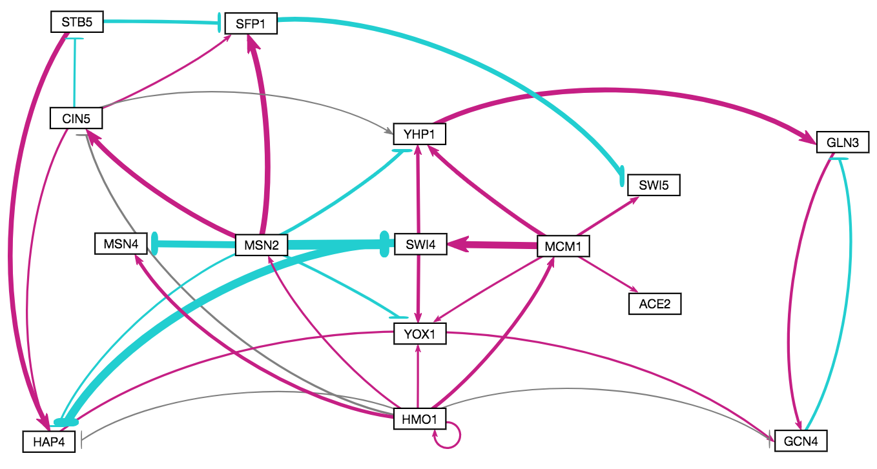
Notes:
Figure 11

